Slide 1

String concatenation with binary +

Slide 2


String concatenation with binary +
usually the plus operator sums numbers
but the plus operator can also concatenates strings

Slide 3

!!!NOTE
If any of the operands is a string, then the other one is converted to a string too
It doesn’t matter whether the first operand is a string or the second one.

Slide 4


!!! IMPORTANT
If first operand is string then the other operands are strings too (regardless what type they are or how many they are)
But if the first operands are numbers (in this case) the operator “+” sums them and then concatenates string to their sum

Slide 5
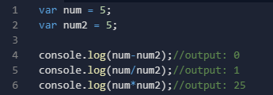
The binary + is the only operator that supports strings in such a way. Other arithmetic operators work only with numbers and always convert their operands to numbers.

Slide 6
Numeric conversion, unary+

Slide 7
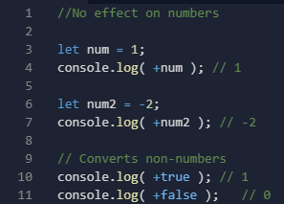
Numeric conversion, unary +
The unary plus applied to a single value, doesn’t do anything to numbers. But if the operand is not a number, the unary plus converts it into a number.

Slide 8
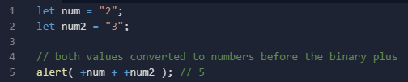
How to sum strings as numbers
We need to convert them (with unary plus) and then sum them (with binary plus)

